Slide 1
E-Manual
Asset Management System

Slide 2
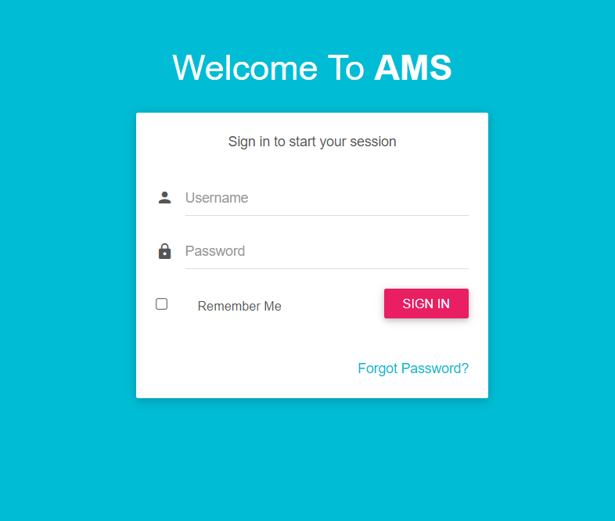
How to login AMS
Enter Your User Name and password

Slide 3
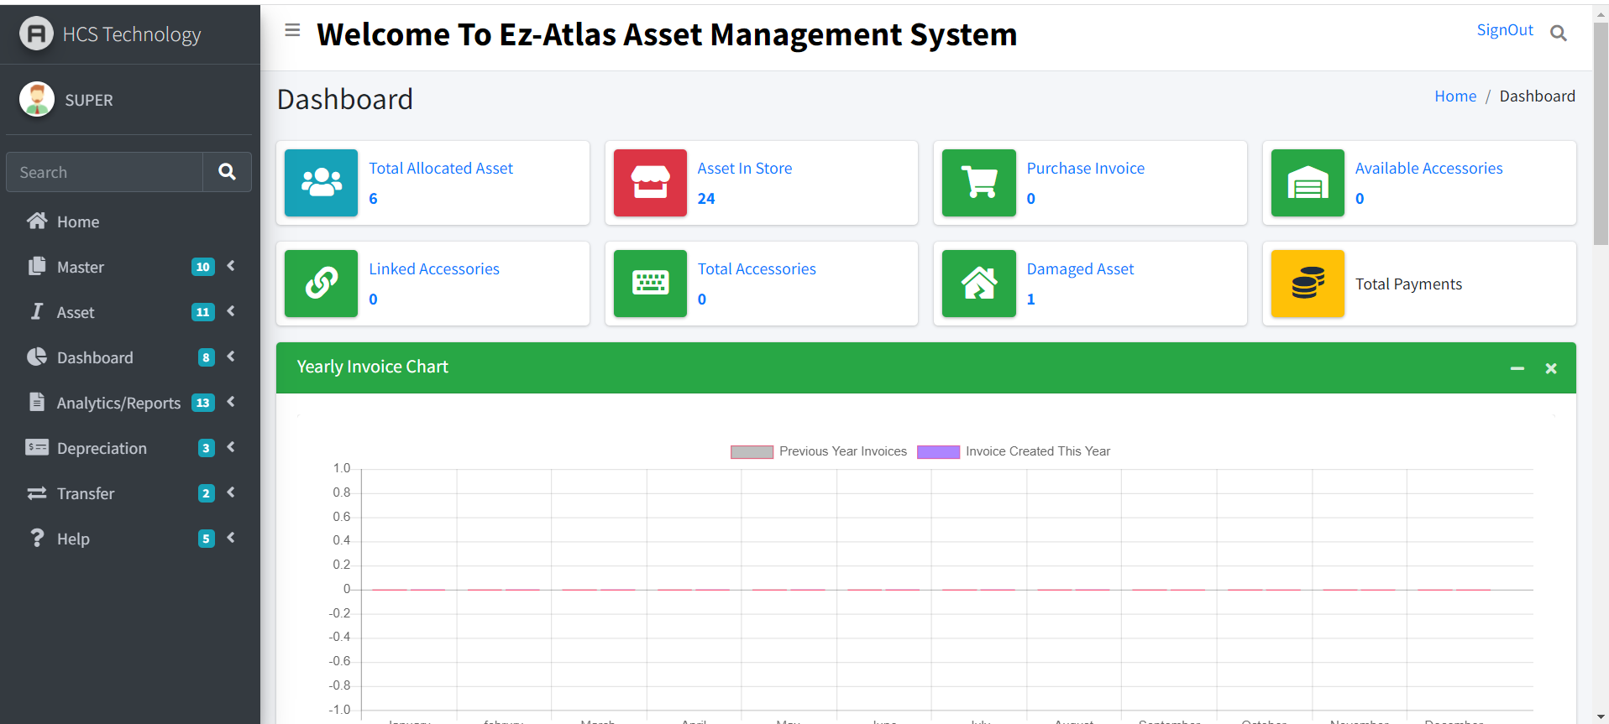
Welcome Screen/Dashboard
Login Profile

Slide 4
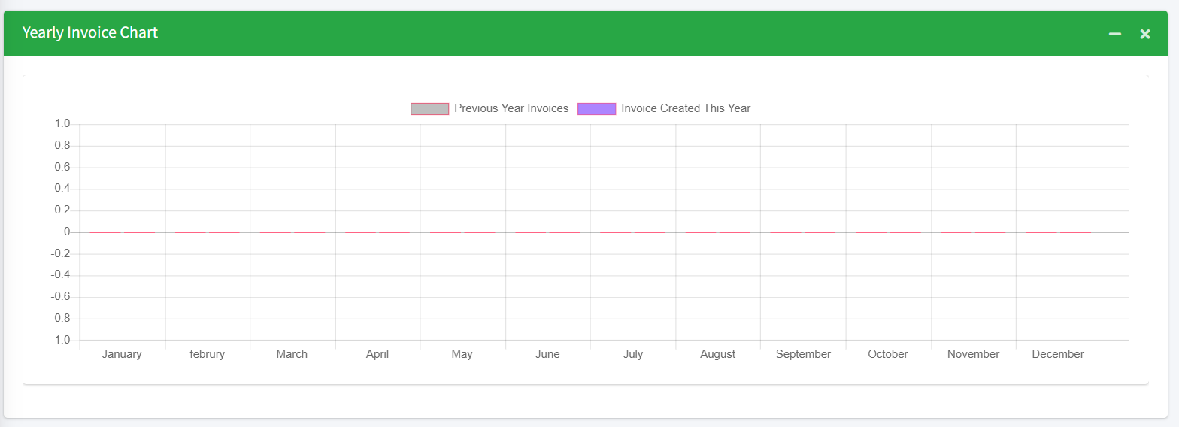
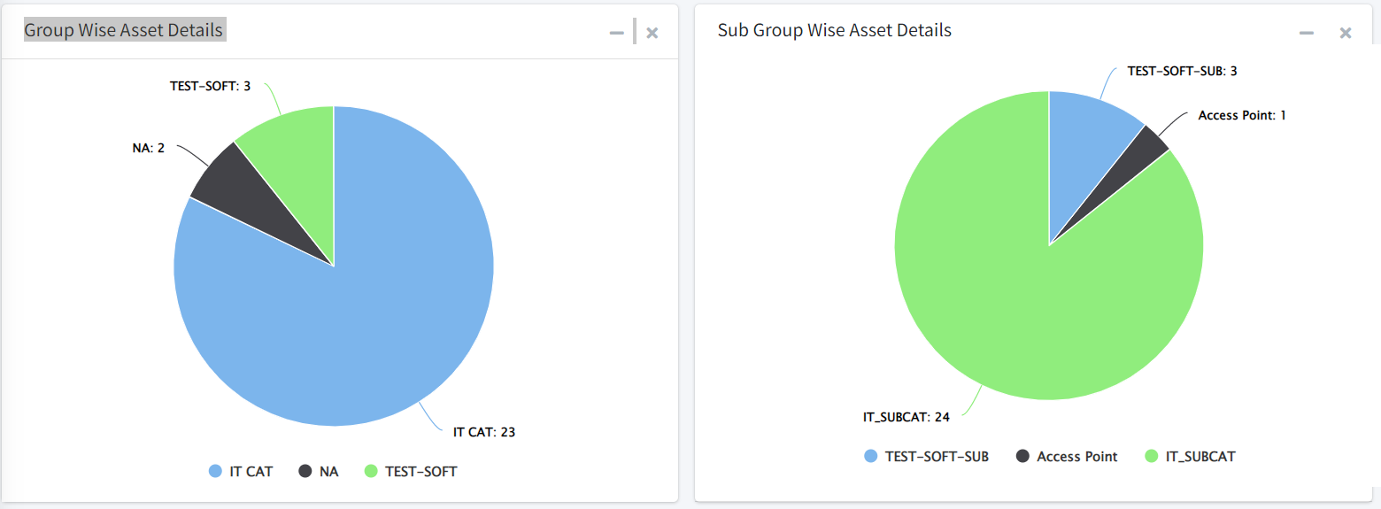
Monthly Invoice Chart in graphical view
FAR in pie Chart

Slide 5
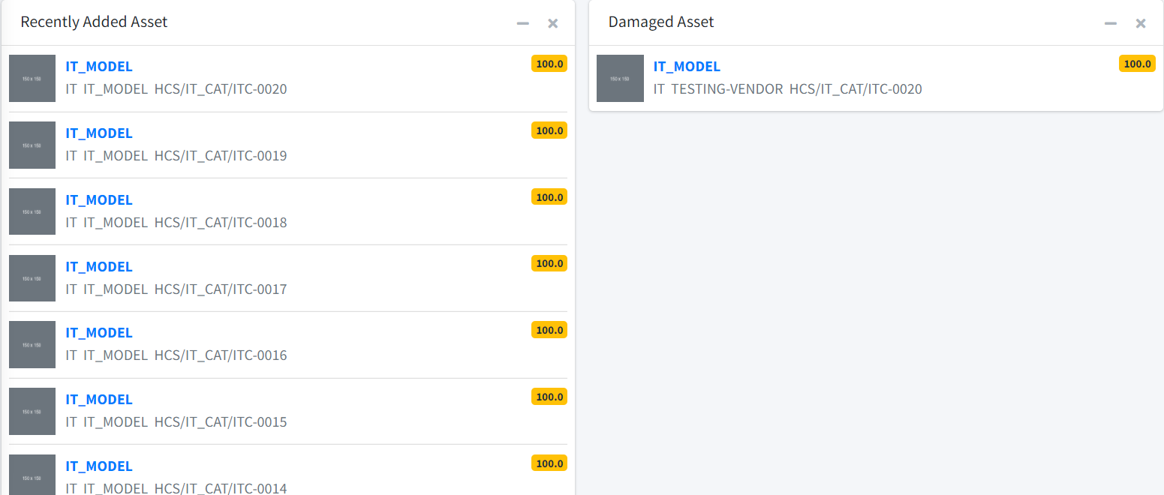
Recently Added Assets View.
It shows all your recent added items. Editable by a simple Click.
To Edit or Add more information, Click on your Desired Asset Name.

Slide 6
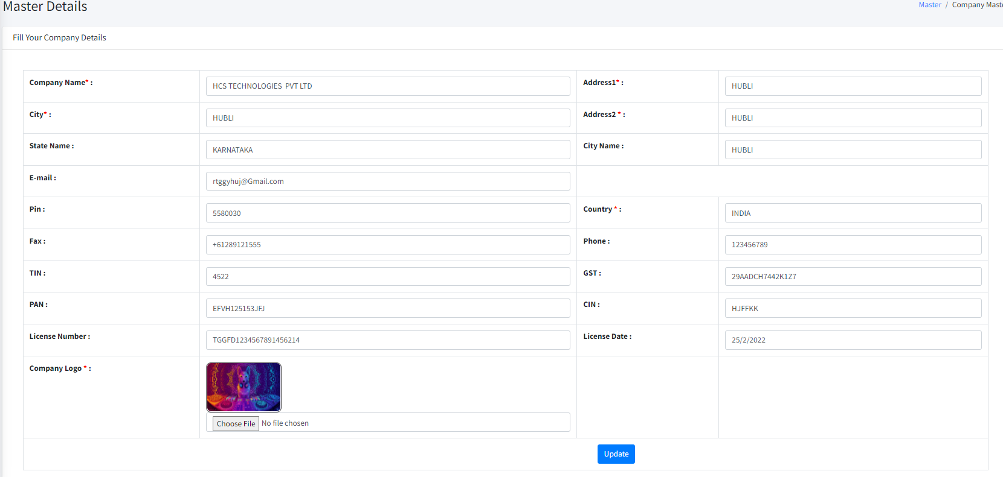
How to Create Company Master?
Follow these following steps:-
1. Click on Company Master
2. Enter All the data in the form
3. Click on the Save button.

Slide 7
How to create Mail Configuration Master?

Slide 8
How to create Geographic Master (Location)?
Following are the steps.
Click on Geographical Master
Click on Location
Enter the Location name and location Code
Click on Save
Note:- You can Update or Delete Location Name and Location Code by clicking on Location Name.

Slide 9
How to create Geographic Master (Sub-Location)?
Following are the steps :-
Click on Geographical Master
Click on Sub-Location
Select Location Name from dropdown
Enter the Sub-Location name.
Click on Save

Slide 10
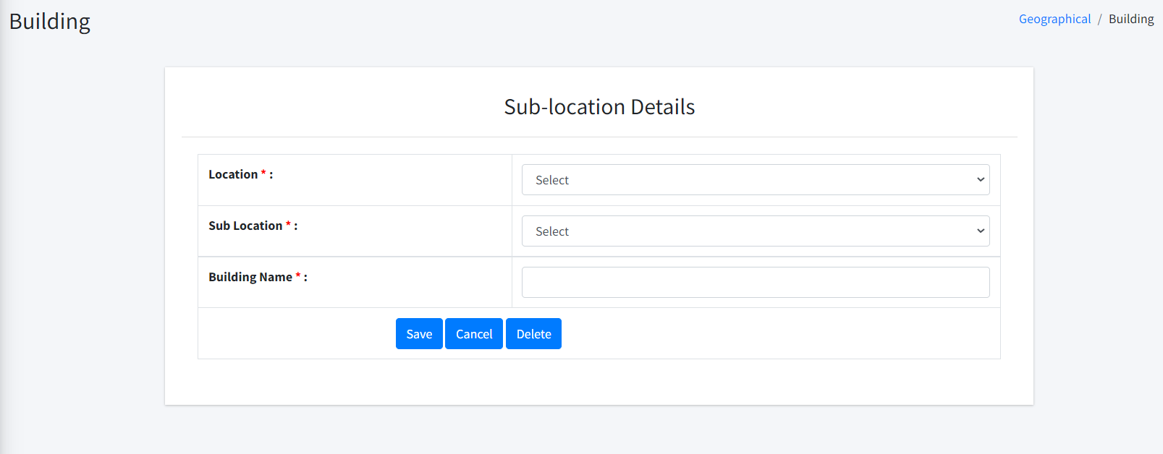
How to create Geographic Master (Building)?
Following are the steps :-
Click on Geographical Master
Click on Create Building
Select Location Name from dropdown
Select Sub-Location Name from dropdown
Enter the Building Name
Click on Save
Note:- You can Update or Delete Building Name by clicking on building name.

Slide 11
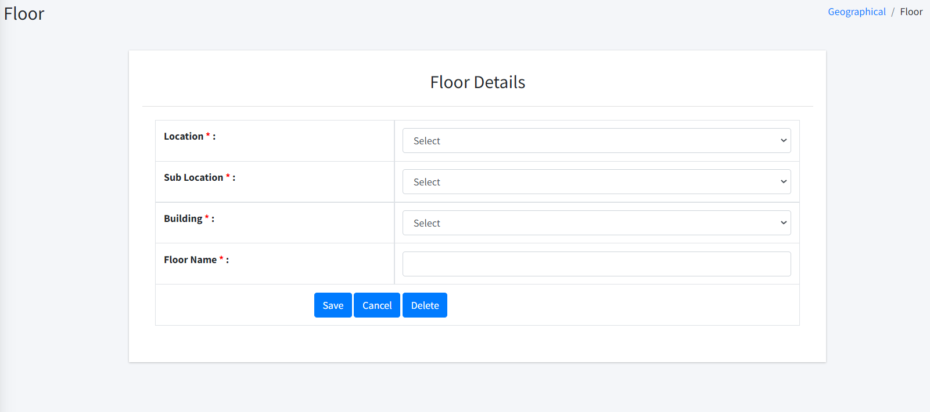
How to create Geographic Master (Floor)?
Following are the steps :-
Click on Geographical Master
Click on Create Floor
Select Location Name from dropdown
Select Sub-Location Name from dropdown
Select Building Name from dropdown
Enter the Floor name
Click on Save
Note:- You can Update or Delete Floor Name by clicking on Floor name.

Slide 12
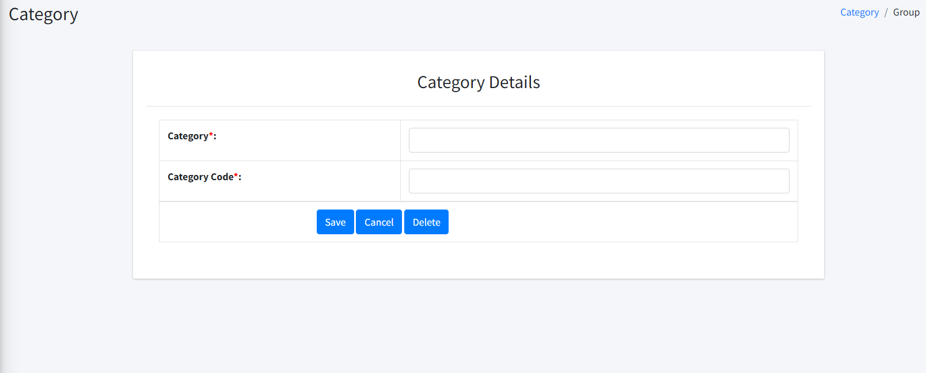
How to create categories Master (Create categories)?
Following are the steps :-
Click on Categories
Click on Create Categories
Enter the Category name and Category Code
Click on Save
Note:- You can Update or Delete Category Name and Category Code by clicking on Category Name.

Slide 13
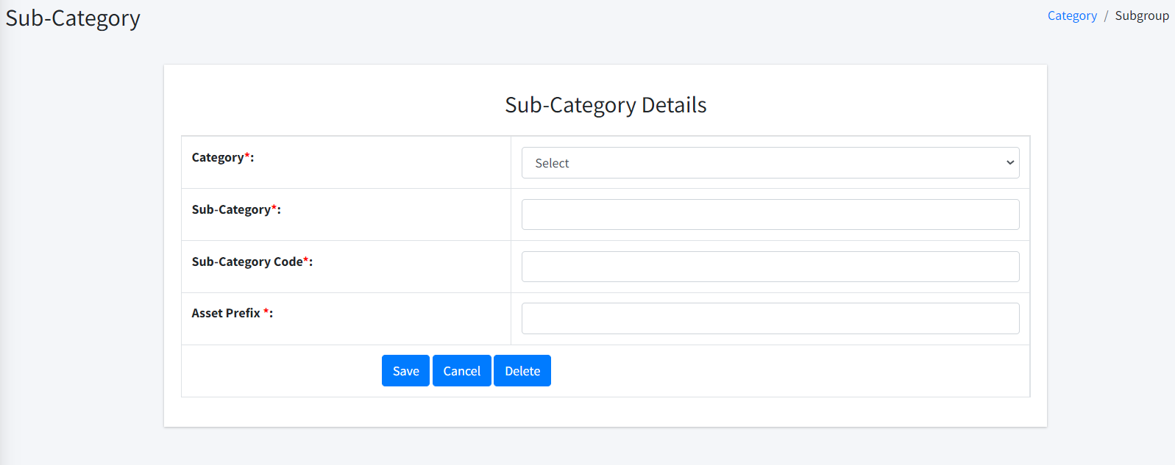
How to create categories Master (Sub- categories)?
Following are the steps :-
Click on categories Master
Click on Sub - categories
Select Category Name from dropdown
Enter the Sub- Category name.
Click on Save
Note:- You can Update or Delete Category Name and Category Code by clicking on Sub- Category Name.

Slide 14
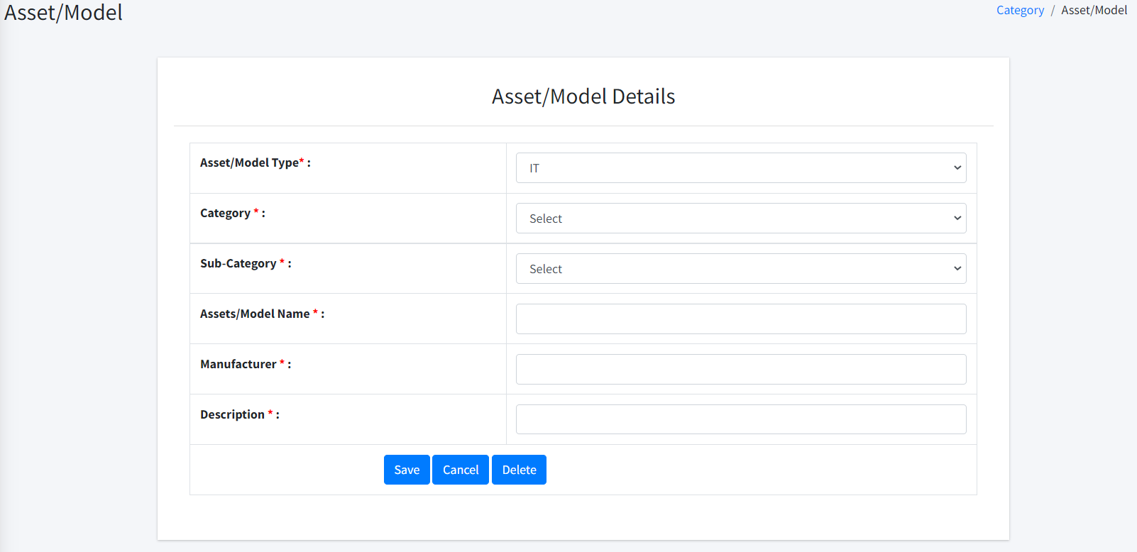
How to create categories Master (Asset / Model)?
Following are the steps :-
Click on Categories Master
Select the Asset Type (IT/NON-IT/SOFTWARE/ACCESSORIES)
Select the Category (map it with Asset type)
Select the Sub-Category
Enter your Model Name
Enter the Manufacturer
Enter Asset Description or Configuration
Click on Save
Note:- You can Update or Delete Category Name by clicking on Asset name.

Slide 15
How to create Department?
Select Department
Put your Department Name
Click on save.

Slide 16
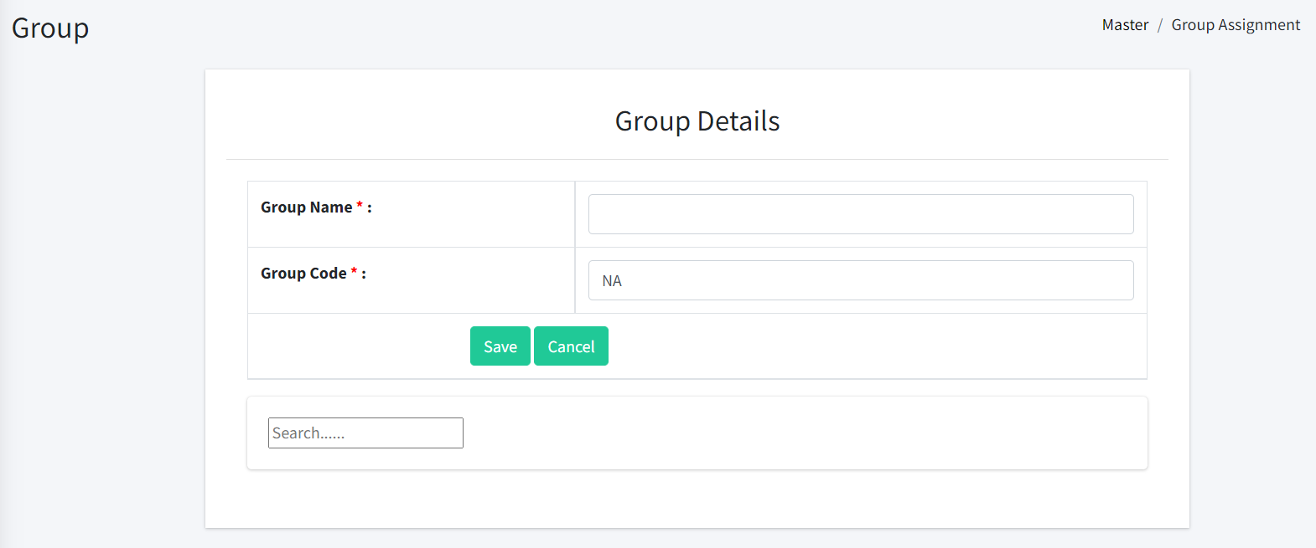
How to create Assignment group?
Select Assignment group
Put your Group Name
Put your Group Code
Click on save.

Slide 17
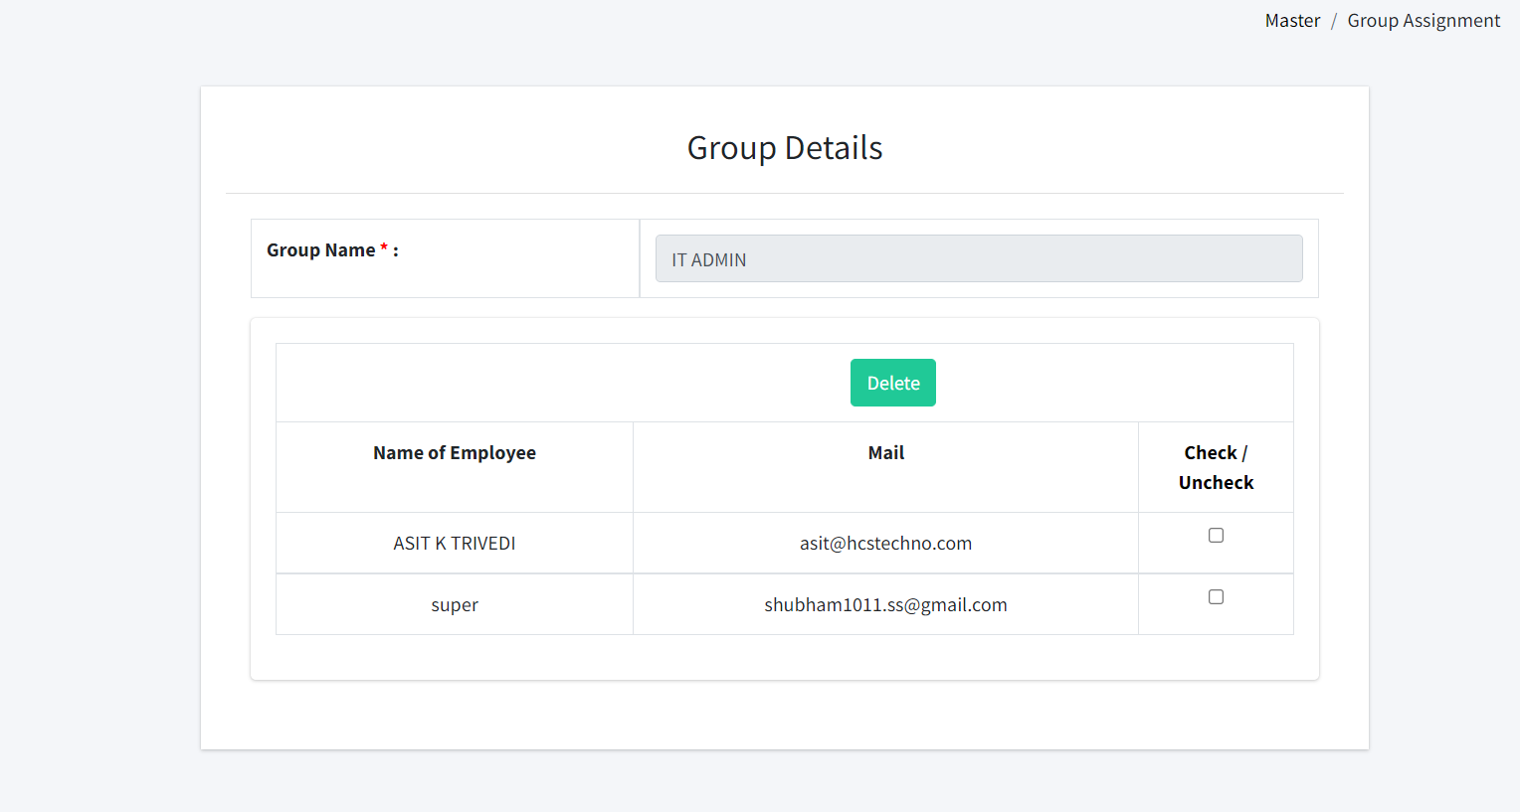
How to create Assignment group?
You can Edit Group
By taking the Group Name
You can change Name of the Employee and check on it .

Slide 18
How to Create Cost Centre?
Following are the steps
Select Cost Centre/Project
Put your details
Click on save.

Slide 19
How to create Administration (User type Master)?
Following are the steps :-
Click on Administration
Click on User type Master
Enter the User type name
Click on Save
Note: And you can Modify or change.

Slide 20
How to create Administration (Designation Master)?
Following are the steps :-
Click on Administration
Click on Designation Master
Enter the Designation name
Click on Save
Note:- You can Update or Delete Designation Name by clicking on Designation Name.

Slide 21
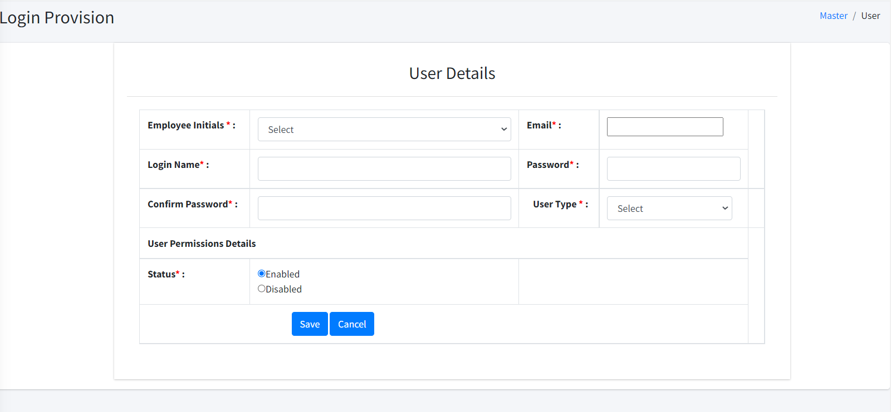
How to create Administration (Employee Master)?
Following are the steps :-
Click on Administration
Click on Employee Master
Select Employee Name, Employee Code, Official Mail ID, Contact No.
Click on Save.
Note:- You can Update or Delete Employee Name Employee Code, Official Mail ID, Contact No.

Slide 22
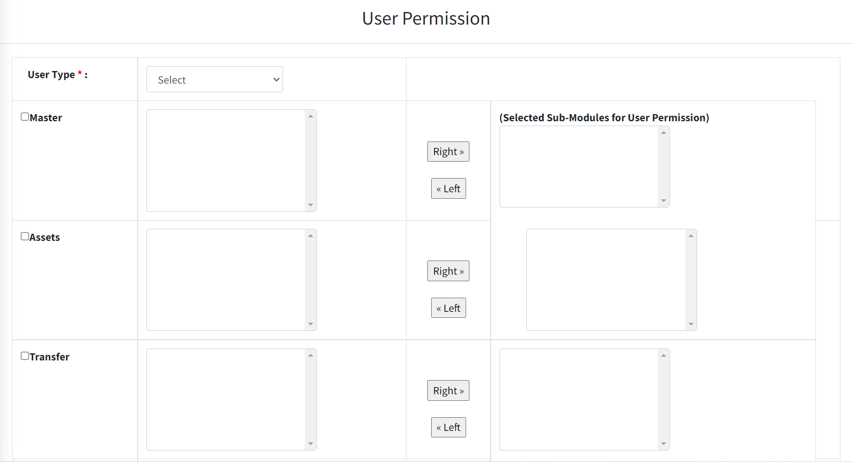
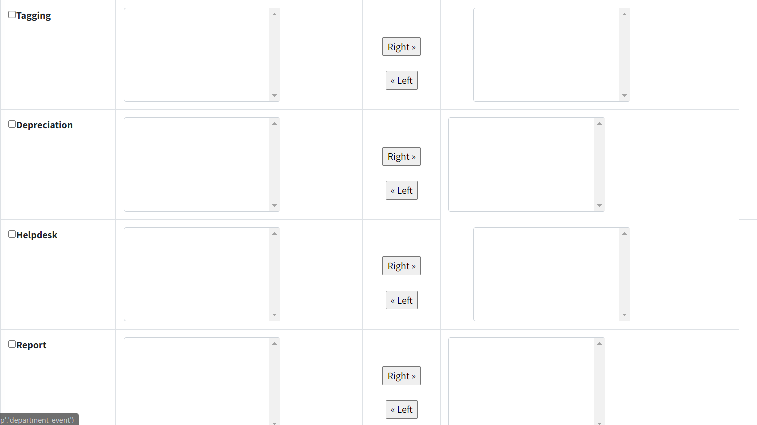
How to Create Administration (User Permission)?
Click on the user Type & Select your user.
Click on the any modules you can get the list.
And you can select sub modules put in the right we don’t need you can put in the lift.
Click on save.

Slide 23
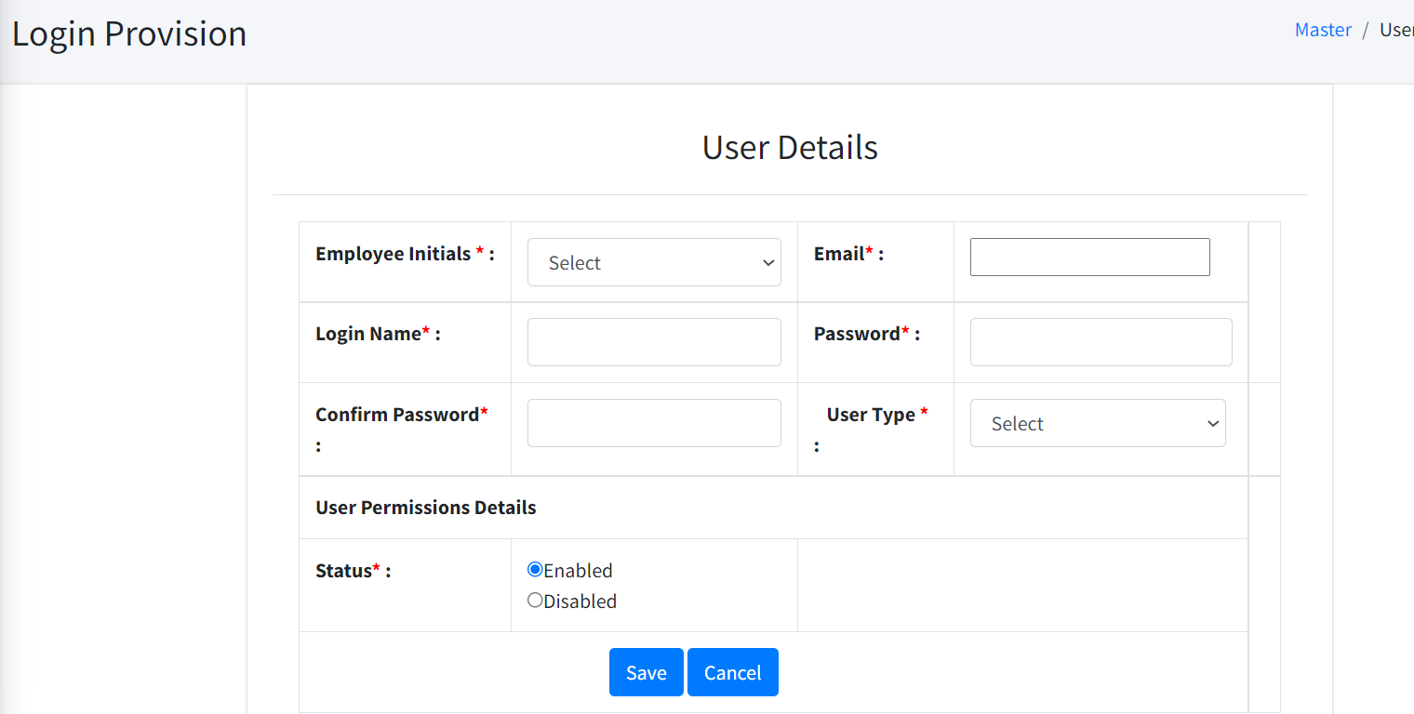
How to Create Administration (Login Provision)?
Enter all the information.
Select the user Type.
Give the user Permissions details (Enabled Or Disabled).
Click on save.

Slide 24
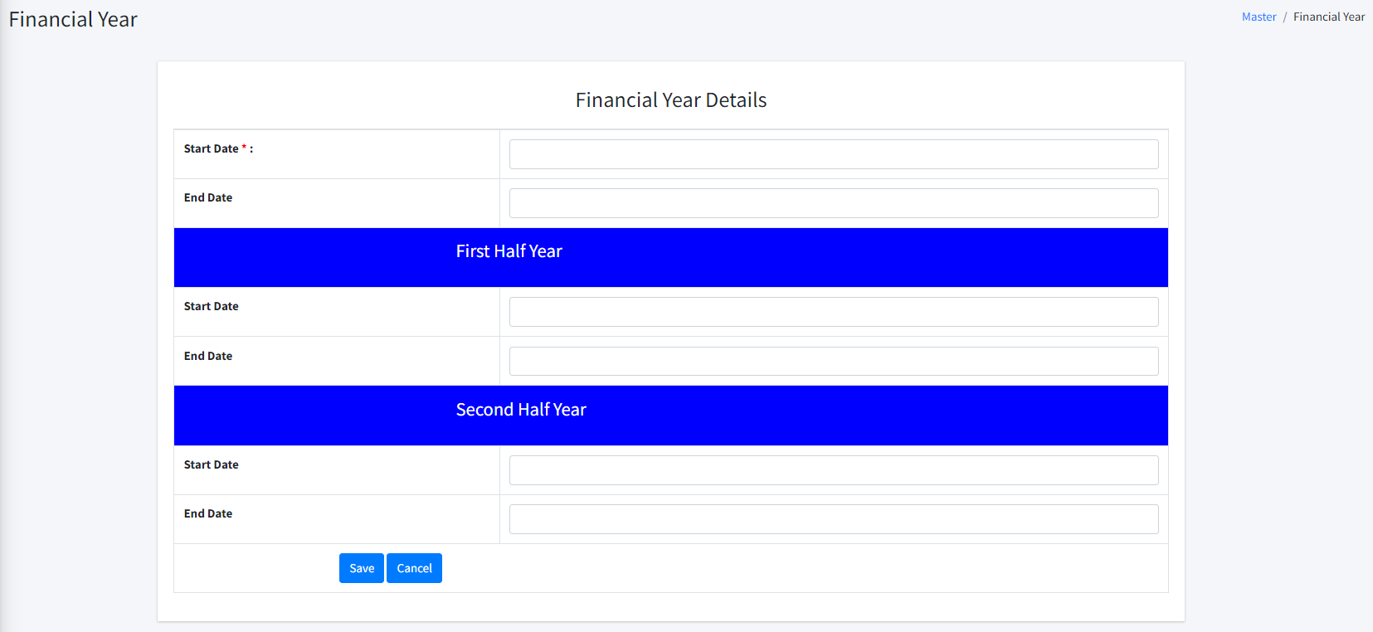
How to Create Administration (Financial Year)?
Click on Administration.
Click on Financial Year.
Select a Start Date from Calendar.
Click on Save.

Slide 25
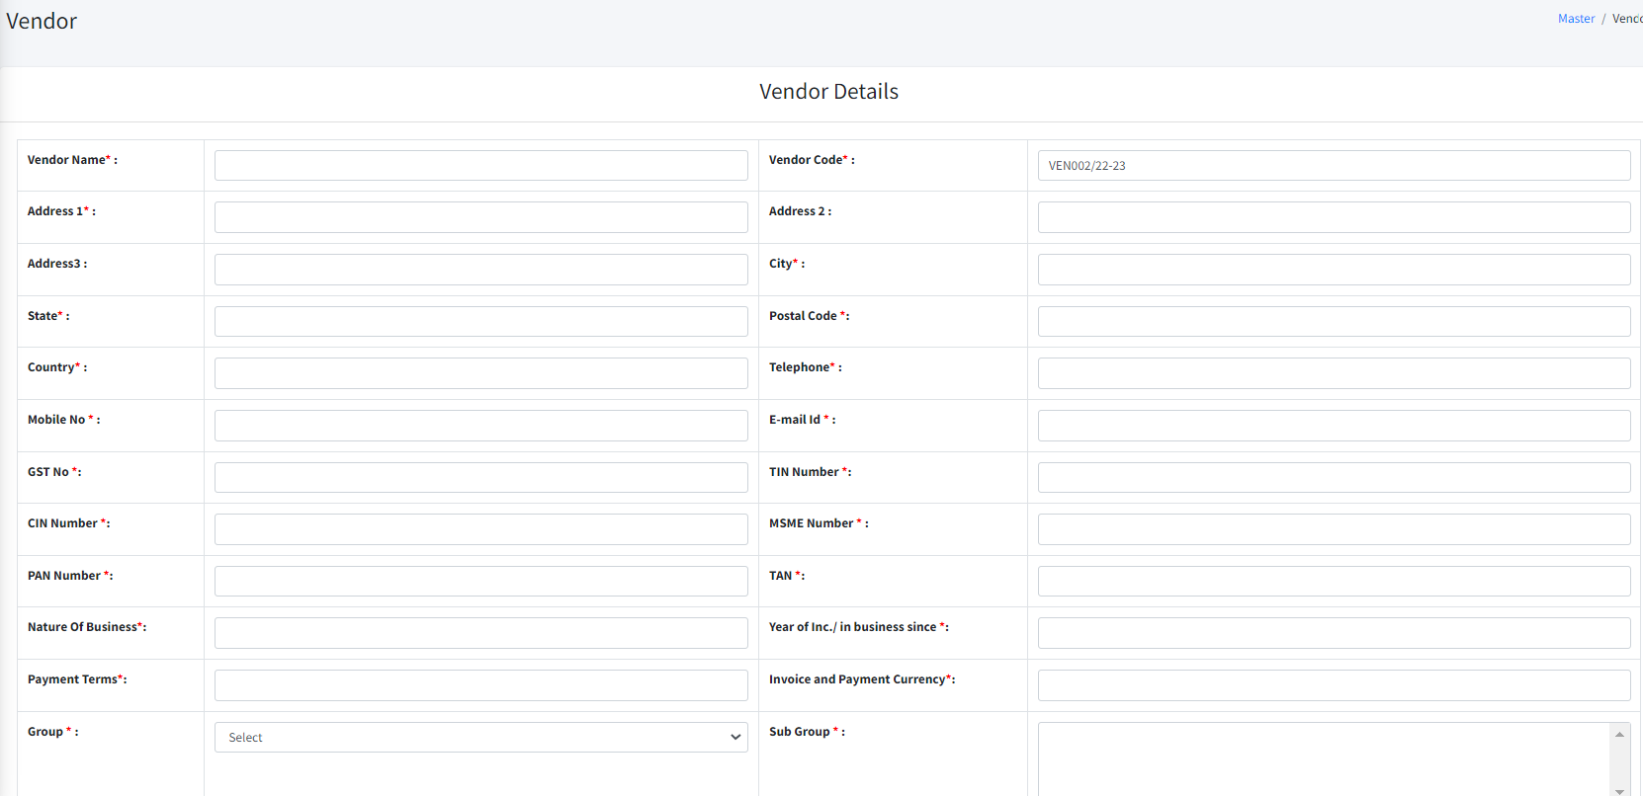
How to create Vendor Master?
We all collect details of the Vendors or Suppliers.
Whom we are purchasing the assets.
We can have all record of the items or assets quality.
Click on Vendor Master
Click on Create Vendor
Enter all the information in the vendor Details.

Slide 26
You should put the Each Certificate Have 25 score .
Put all the Bank Account Details.
Put all the Details of Contact Person.
Click on save.

Slide 27
How to create Tax Details ?
Go to Master
Click on Tax Details
Enter Tax1 Name
Enter Tax2 Name
Enter Tax1 Percentage
Enter Tax2 Percentage
Click on Save.

Slide 28
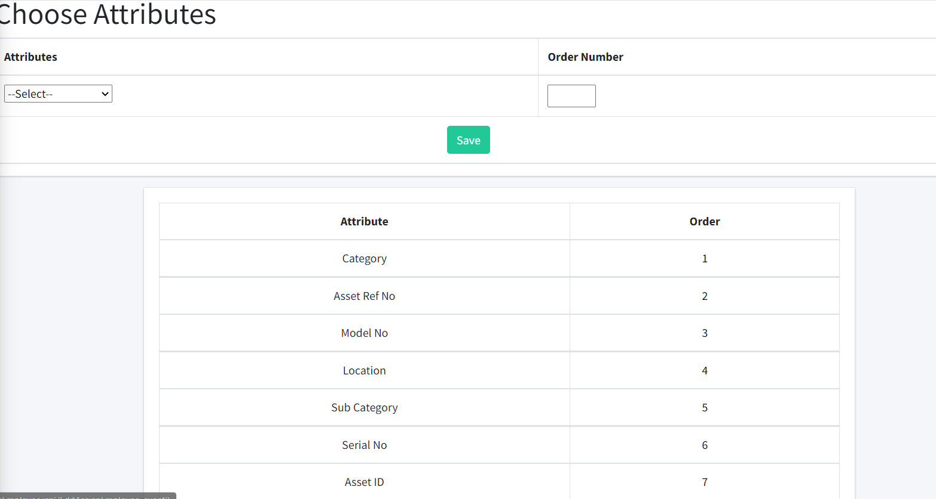
How to create Custom Tag Printing?
Go to Master
Click on Custom Tag Printing
Drop down Attributes and Order Number
Click on Save.

Slide 29
How to create My Assets?

Slide 30
How to create Assets ?
Go to Assets
Assets Modules in which we are capturing the invoice of the assets
The we are pushing that assets to our store.
Add to Store by assigning the serial number to the assets.
Once we done all the process we put to use that assets to our employee by allocating them.
There are various tools to capture:
Invoice Entry
Add to Store
Tag Printing
Edit Assets
Allocate
De Allocate
Link Accessories
De link Accessories
Approve Damage Assets
Scanning

Slide 31
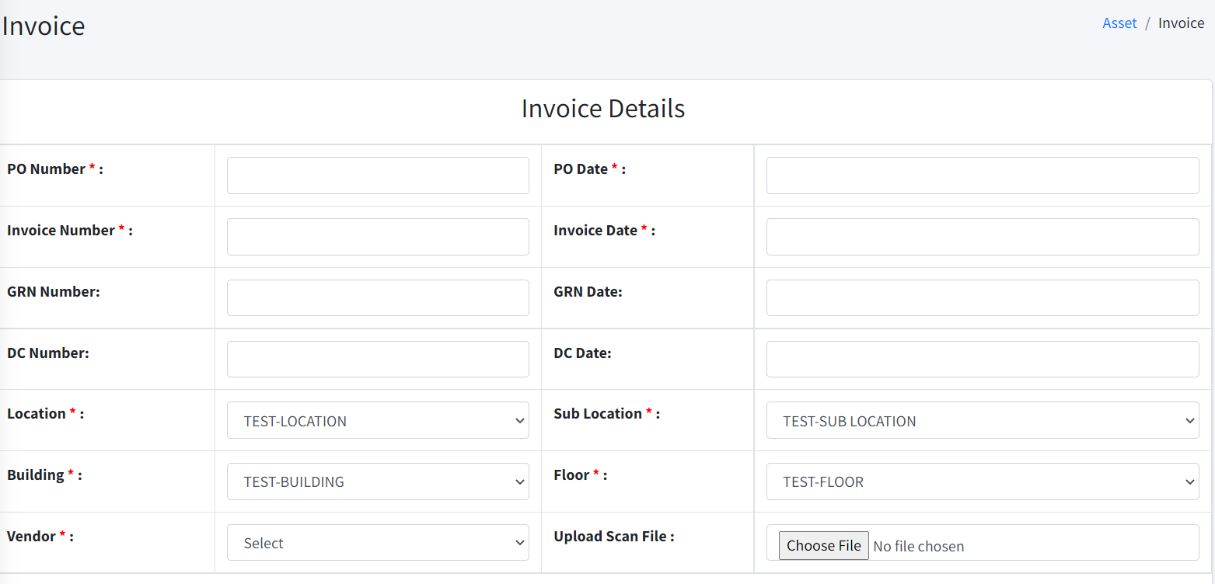
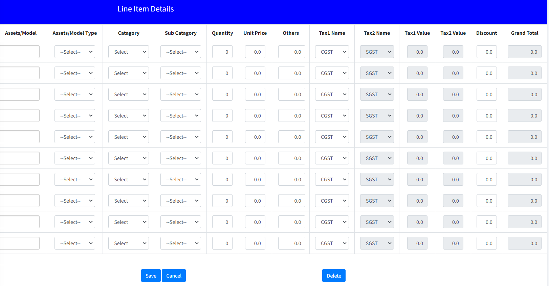
How to create Invoice Entry ?
Go to Asset
Click on Invoice Entry
Enter PO Number and Date
Enter Invoice Number and Date
Enter Country, City and City Sub Location
Select the Name of the Vendor from dropdown
Upload file
In line Item details Enter Model or Item name, quantity and unit price
Select the various taxes
You can add as many Line items details by clicking on Add.
Click on Save.

Slide 32
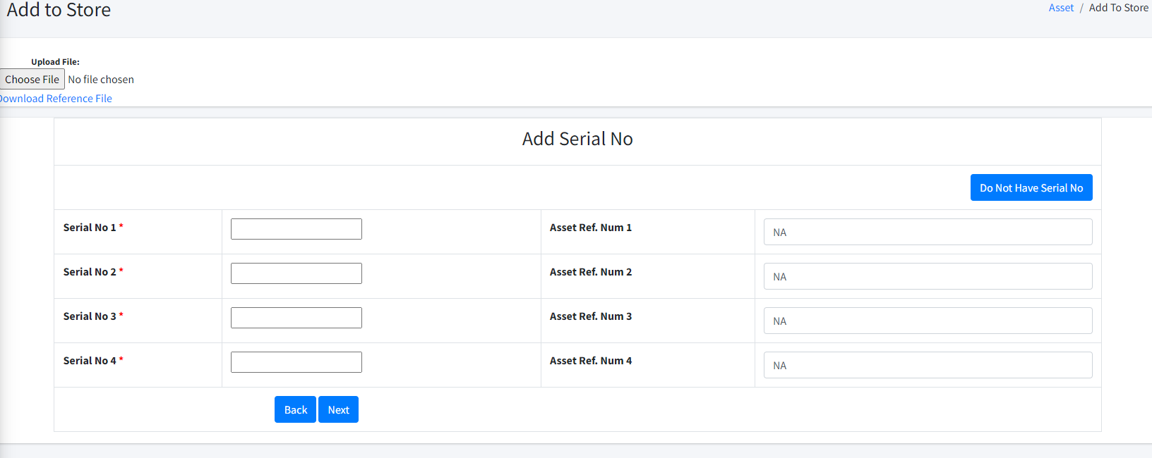
How to create Add store ?
The invoice now our next step to put the Assets to our Store.
Go to Asset
Click on Add to Store
Select the Items and click on Add to Store
Assign Serial Number and Reference Number
Click on Next

Slide 33
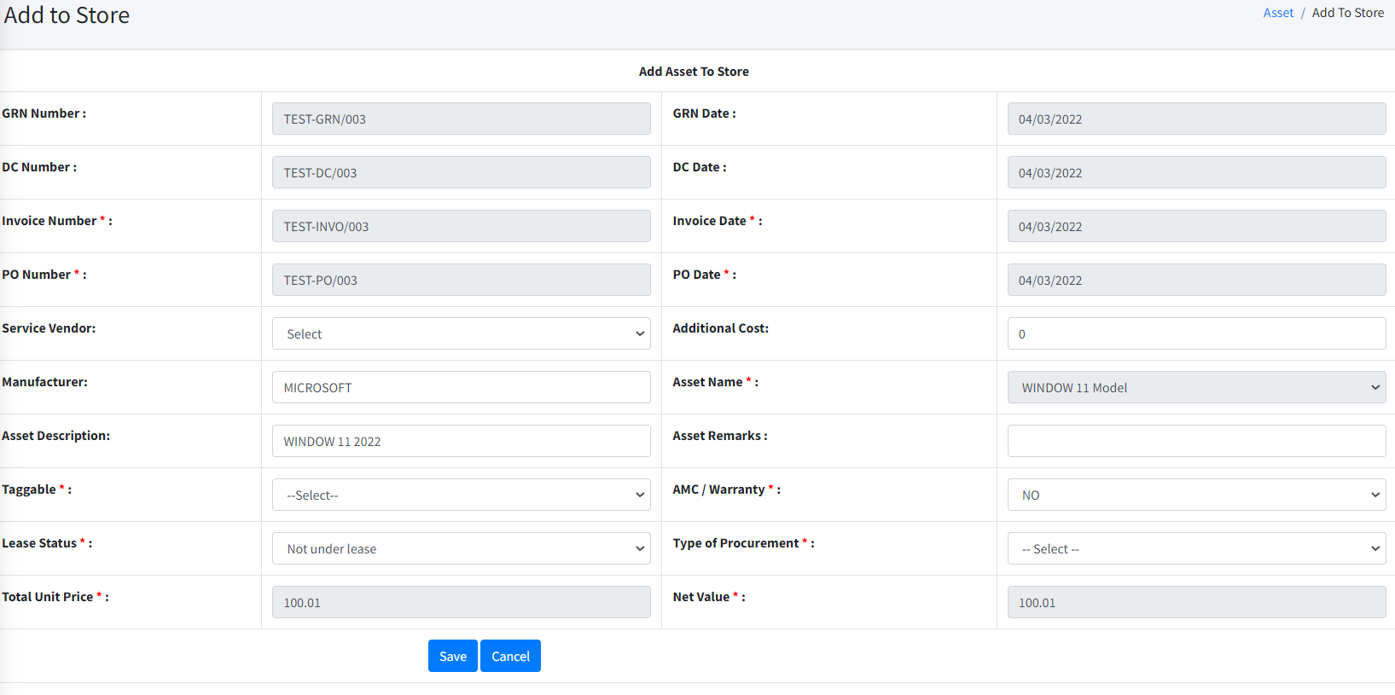
How to create Add store ?
Now, Asset Details page will open, Enter all information with respective part.
Select whether item is Taggable or Not
AMC or Warranty if, Yes, Select Start Date and End Date, so email will trigger before deadline
Select Lease Status and Purchase Mode
Click on Save.

Slide 34
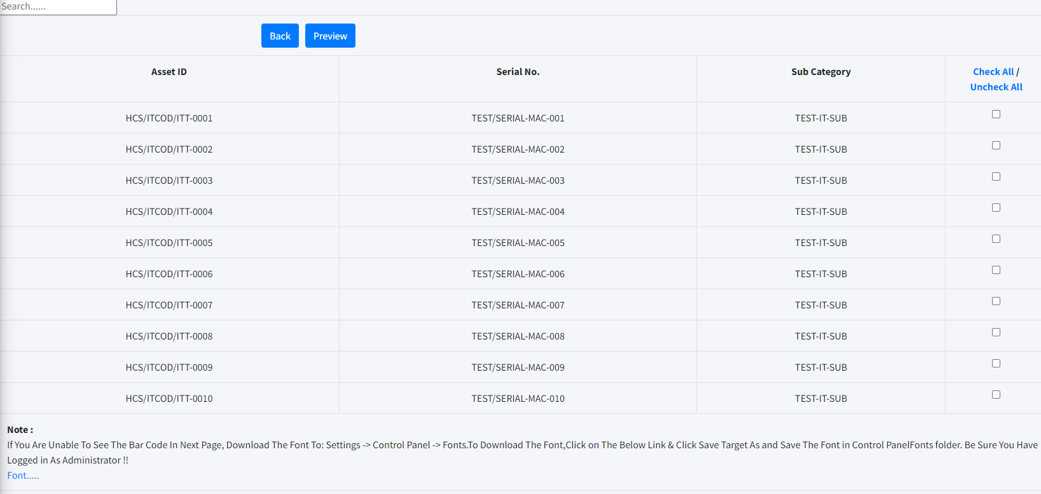
How to create Tag Printing ?
Go to Asset
Click on Tag printing
Category & Sub Category
In Category drop down
Sub category drop down
Click on next
You can get search option
You will get Assets id ,Serial no , Sub Category which Assets Id you need Check And click on preview.

Slide 35
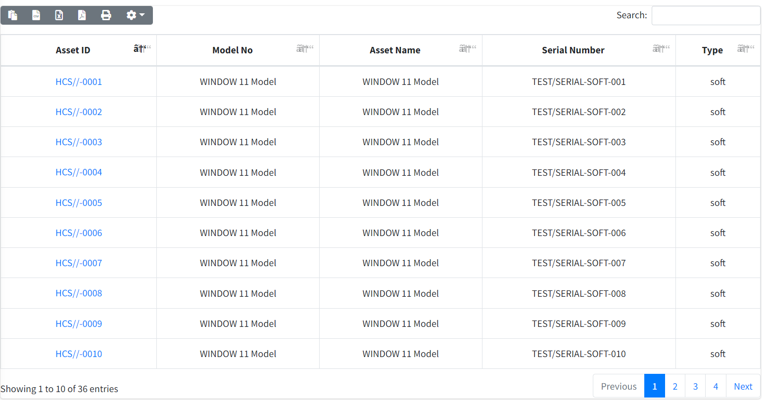
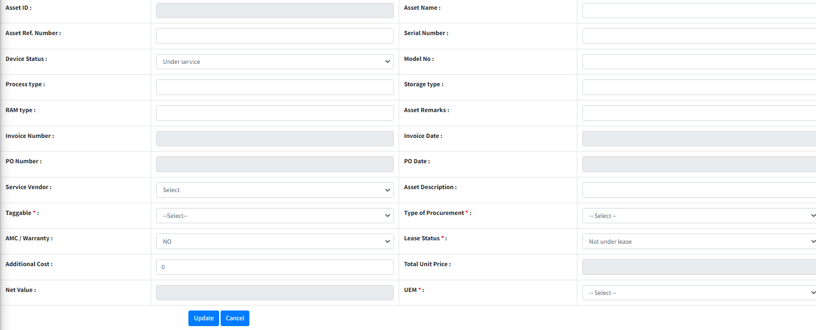
How to create Edit Asset ?
Go to Asset
Click on Edit assets
Click on Asset Id
Click on Update

Slide 36
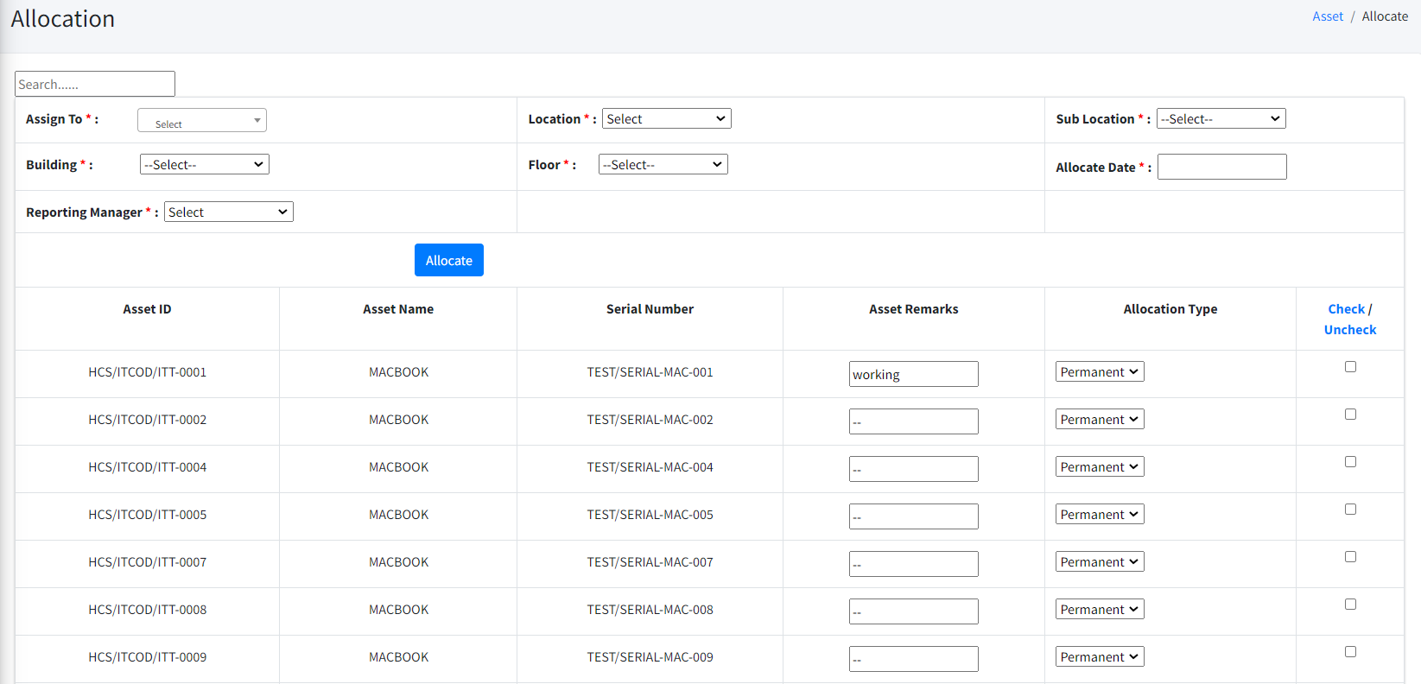
How to create Allocate?
The asset is ready to put in use by allocating to our employee.
Go to Asset
Click on Allocate
Select the name of Employee
Tool will automatically capture details of employee
Select Date of Allocation
Tick on box of asset and assign allocation nature i.e. Permanent or Temporary.
Click on Allocate
Email will trigger to employee of this allocation.
After acceptance Asset will allocated

Slide 37
How to create De allocate?
Employee is transferred or Retirement or any such situation.
So we do Deallocation the assets from the employee account.
Go to Asset
Click on Deallocate
Select the name of Employee
Tick on the box and Enter date of deallocation.
Click on Deallocate
Email will trigger to employee of this deallocation.

Slide 38
How to Create Damaged Assets?
While deallocation an asset if the device status is damaged, it will go to damaged asset…

Slide 39
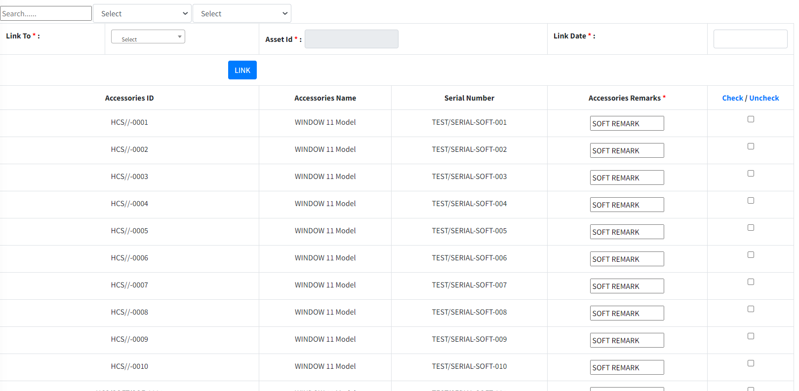
How to Create Link Accessories?
Which some Installation of Software or any External device need to link
Go to Asset
Click on Link Accessories
Select the Asset from dropdown
Tick on the box against the accessories which is intended to link and Enter date of Link
Click on Link.

Slide 40
How to Create Delink Accessories ?
Employee is transferred or Retirement or any such situation
So we do Deallocation the assets from the employee account.
Go to Asset
Click on Deallocate
Select the name of Employee
Tick on the box and Enter date of deallocation.
Click on Deallocate
Email will trigger to employee of this deallocation.

Slide 41
How to Create Approve Damaged Assets?
While deallocation an asset if the device status is damaged, it will go to damaged asset…
Click on Modify.

Slide 42
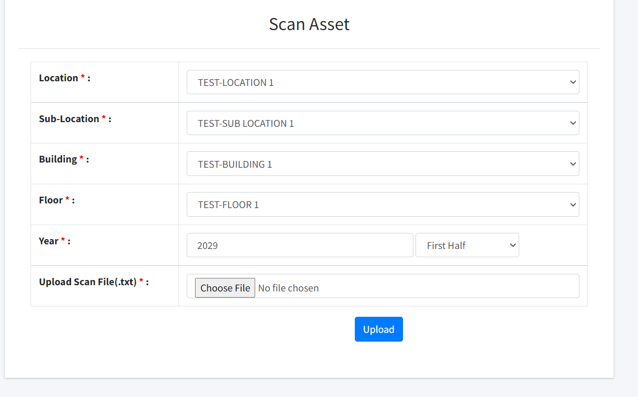
How to do Scanning?
Click on Scanning
You get the scan Asset
Drop down in Location
Drop down in Sub-Location
Drop down in Building
Drop down in Floor
Put the Year
Upload Scan File( Choose file)
And Upload

Slide 43
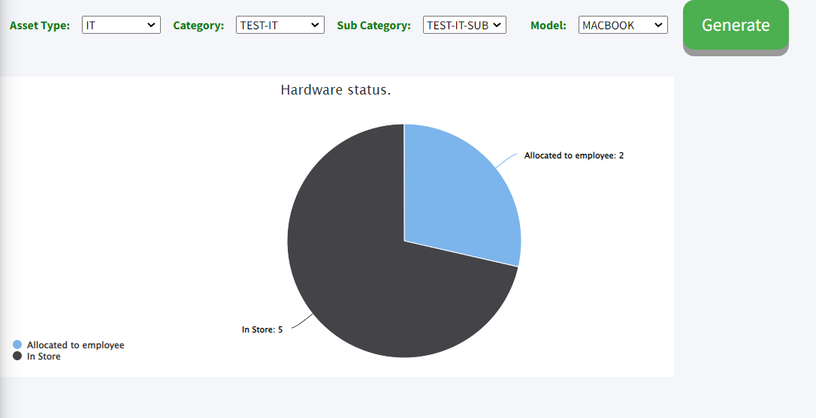
How to Create Dash Board(Hardware Status)?
Click on Dash Board
In Dash board Click on Hardware Status
Drop down in Asset Type
Drop down in Category
Drop down in Sub-Category
Drop down in Model
Click on Generate You will get pia Chart Status

Slide 44
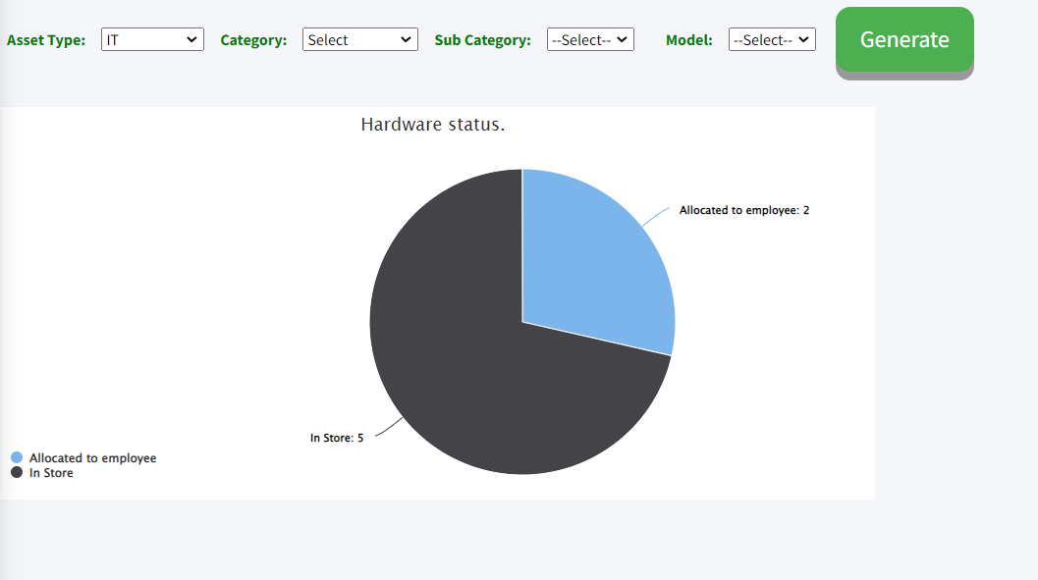
How to Create Complete stock?
Click on Complete Stock
Drop down in Asset Type
Drop down in Category
Drop down in Sub-Category
Drop down in Model
Click on Generate You will get pia Chart Status.

Slide 45
How will get Category Wise Asset Details?
Will get Category Wise Asset Detail
In the Pai chart.

Slide 46
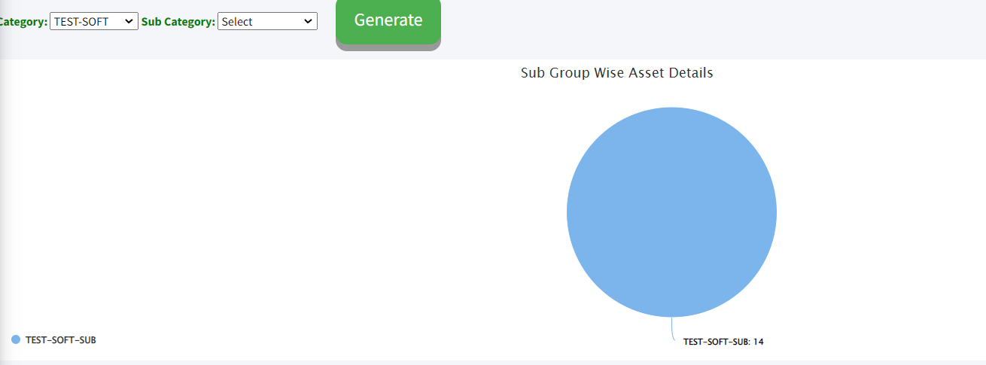
How will get Sub Group Wise Asset Details?
Click on Sub group wise Asset
Drop down Category
Drop down Sub Category
Click on Generate
Get the pai chart

Slide 47
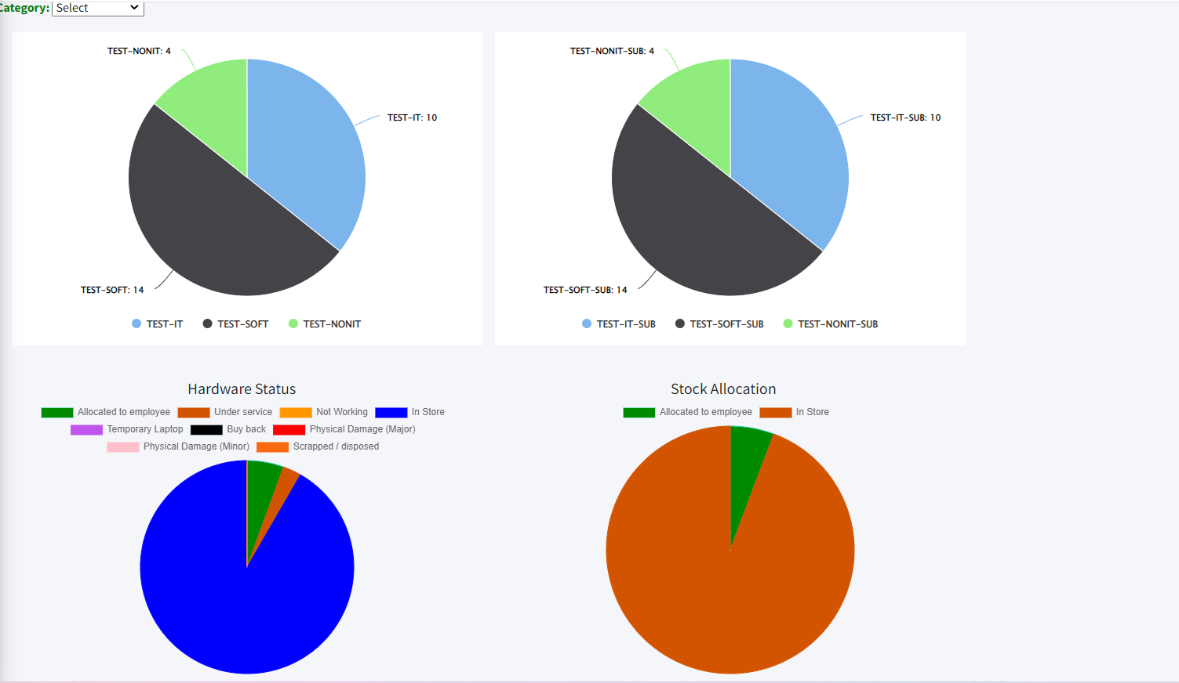
How will get Asset Status?
Click on asset Status
Drop down Category
You get the Pai chart.

Slide 48
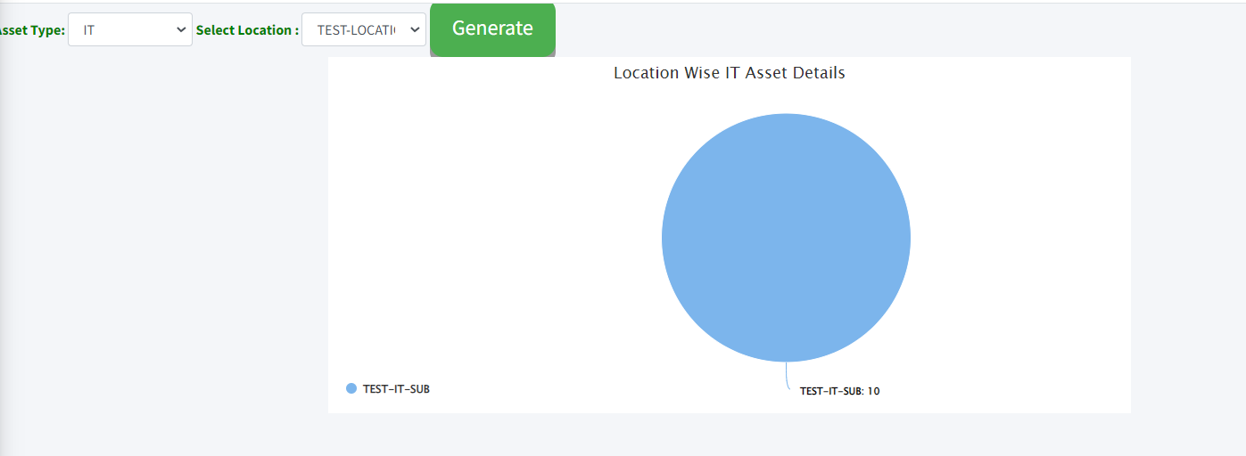
How will get Location Wise IT Asset Details?
Click on IT Asset
Drop down Asset Type
Drop down Select location
Click on generate.

Slide 49
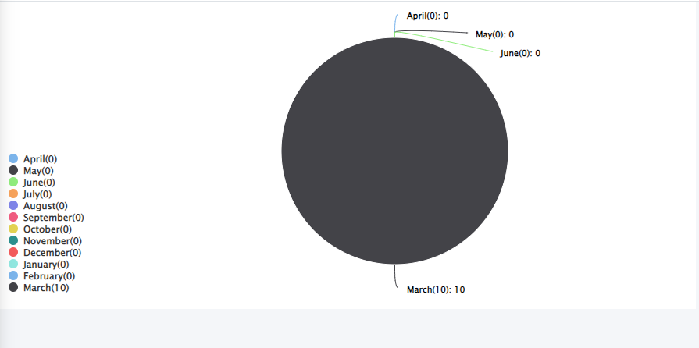
How will get Transfer?
Click on Transfer
We will Get graph

Slide 50
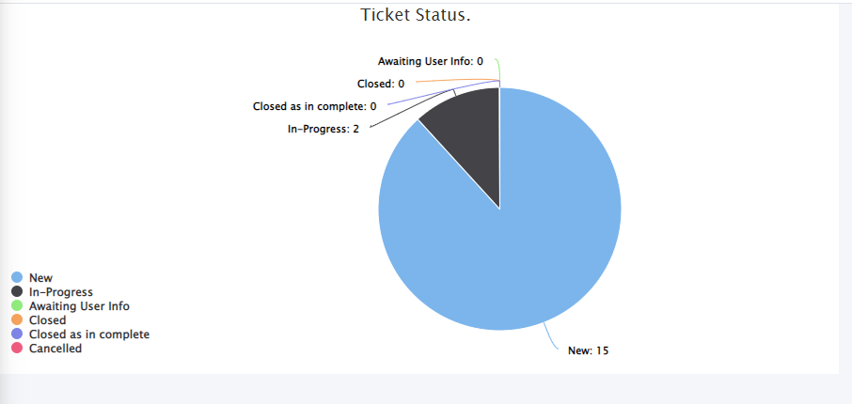
How will get Help disk?
Click on Help Disk

Slide 51
How will get AMC/Warranty?
Click on AMC / Warranty
Drop down Month
Drop down Year
Click on generate.
You will get the Pie/Bar chart

Slide 52
How to generate master assets report?
Click on the analytics/report
Click master assets report
Select asset group
Select asset sub group
Select location
Select sub location
Click on report.

Slide 53
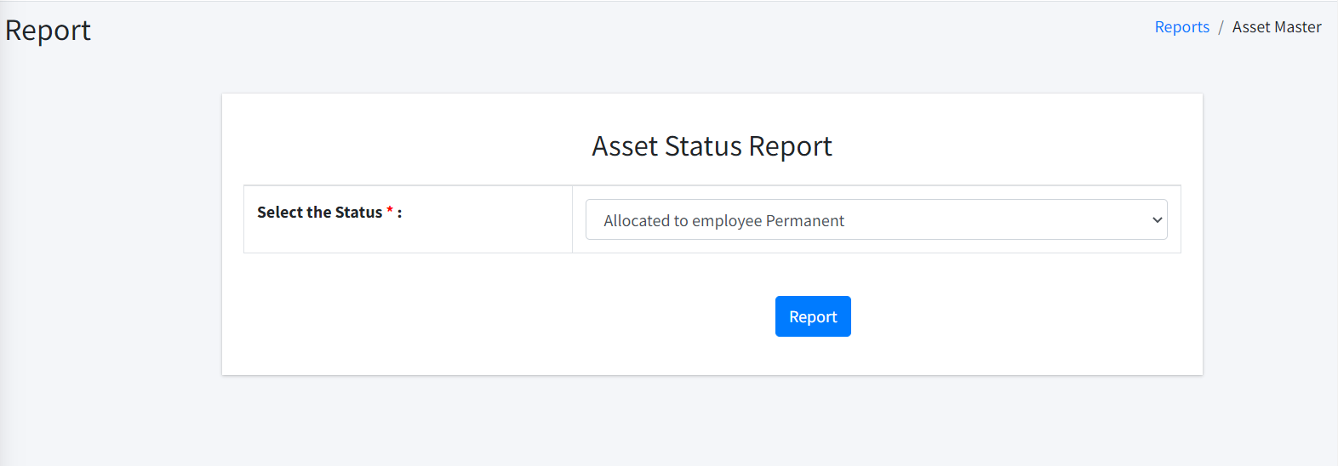
How to generate assets status report?
Click on the analytics/report
Click assets status report
Select the status
Click on report
Note :- If you want to see all assets status report at once select status as all and click on the report.

Slide 54
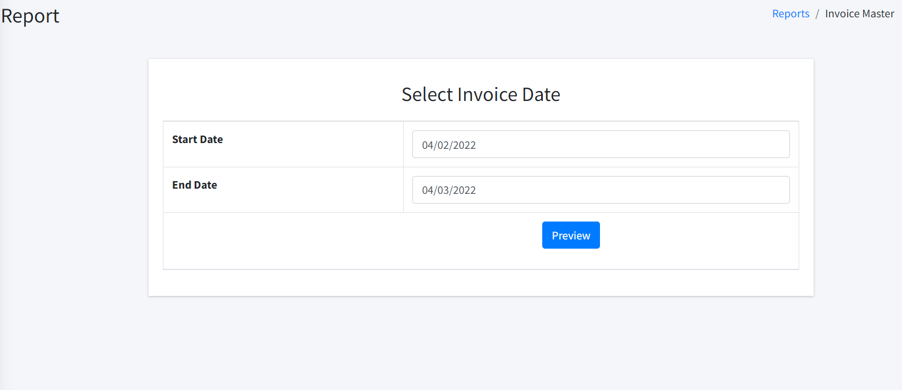
How to generate Invoice assets report?
Click on the analytics/report
Click Invoice assets report
Select start date
Select End date
Click on preview
Note :- if you want to see all Invoice assets report at once start date and end date as all and click on the preview.

Slide 55
How to generate Employee wise report?
Click on the analytics/report
Click Employee wise report
Select Employee Name
Click on report
Note :- if you want to see all Employee wise report at once select Employee Name as all and click on the report.

Slide 56
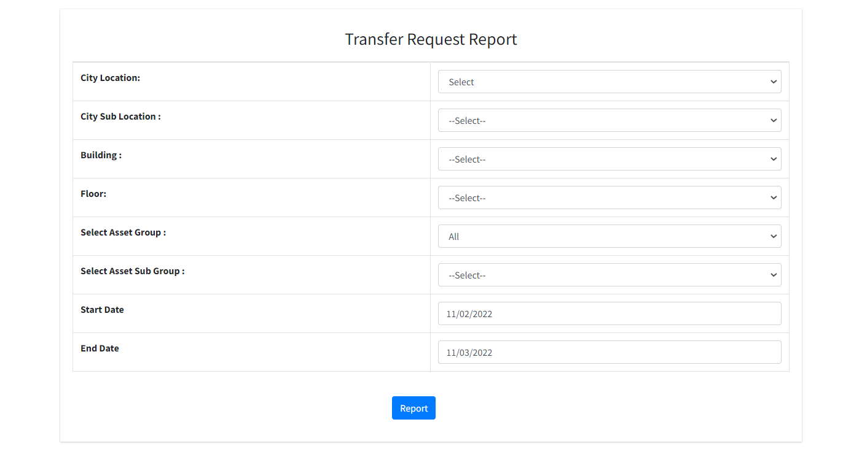
How to generate Transfer Request Reports?
Click on the transfer Request Reports
Select City Location
Select City Sub location
Select Building
Select Floor etc.
Click on report

Slide 57
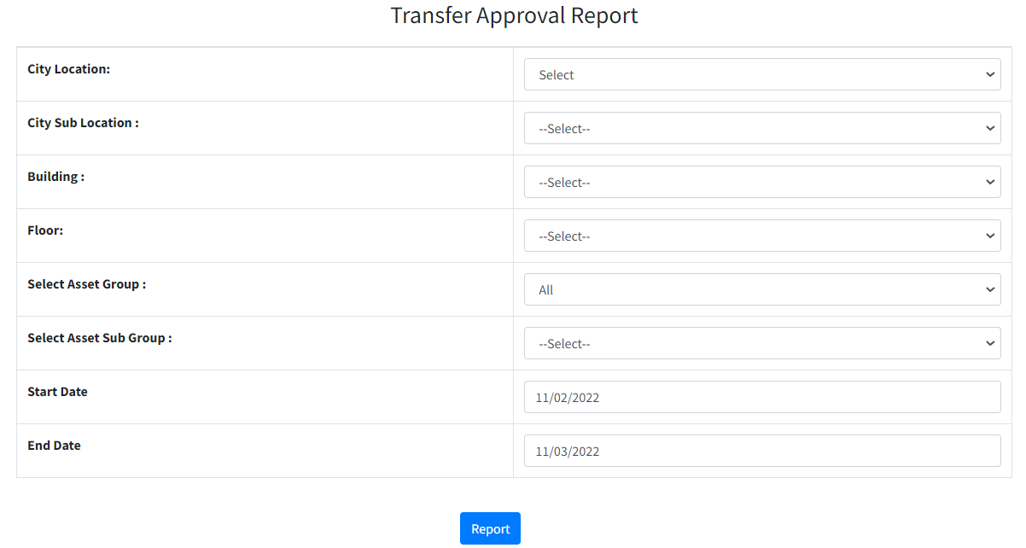
How to generate Transfer Approval Reports?
Click on the Transfer Approval Reports
Select City Location
Select City Sub location
Select Building
Select Floor etc.
Click on report.

Slide 58
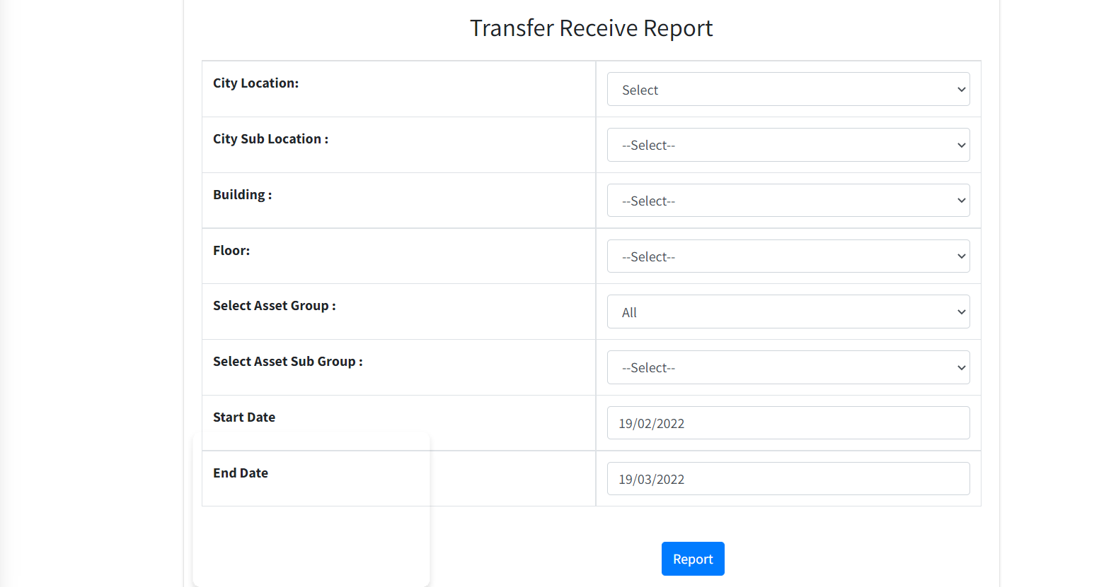
How to generate Transfer Reports?
Click on the Transfer Reports
Select City Location
Select City Sub location
Select Building
Select Floor etc.
Click on report.

Slide 59
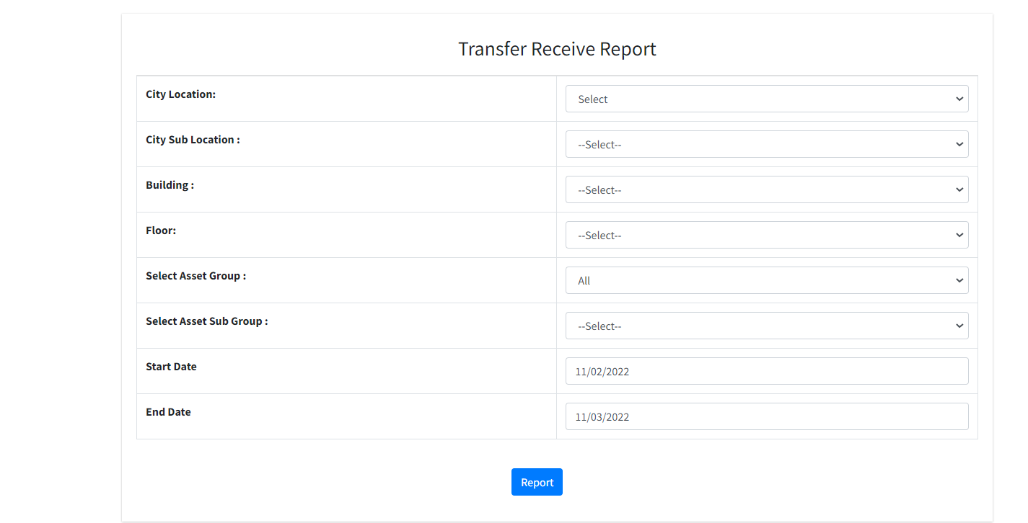
How to generate Transfer Receive Reports?
Click on the Transfer Receive Reports
Select City Location
Select City Sub location
Select Building
Select Floor etc.
Click on report

Slide 60
How Will get Accessory/Software History Reports?
Click on the Accessory/Software History Reports
Select the Asset Group
Select the Asset Sub Group
Select the Model
Click on Preview we will get excel sheet.

Slide 61
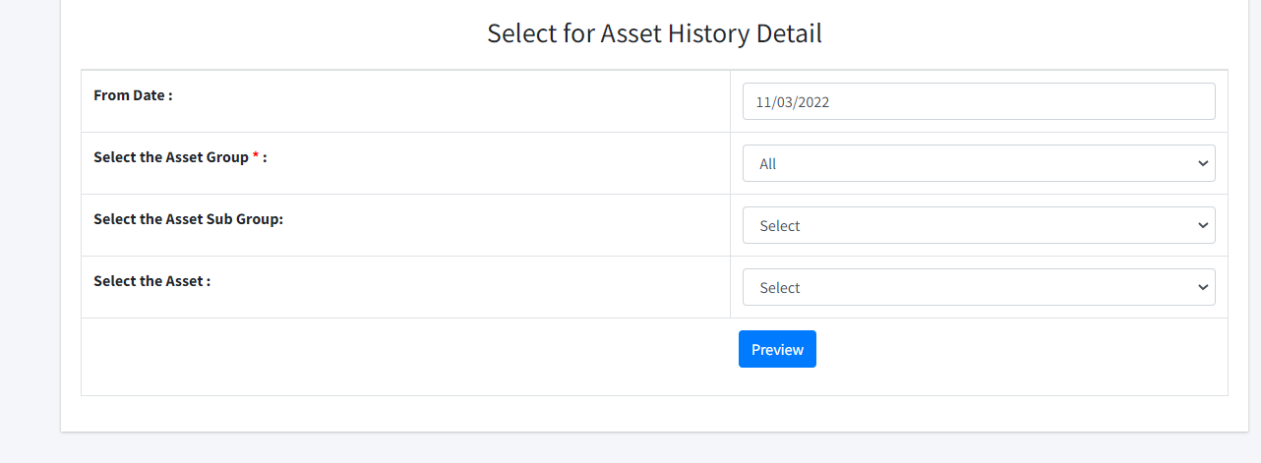
How Will get Asset History Reports?
Click on the Asset History Reports
Select the Date
Select the Asset Group
Select the Asset Sub Group
Select the Asset
Click on Preview we will get excel sheet.

Slide 62
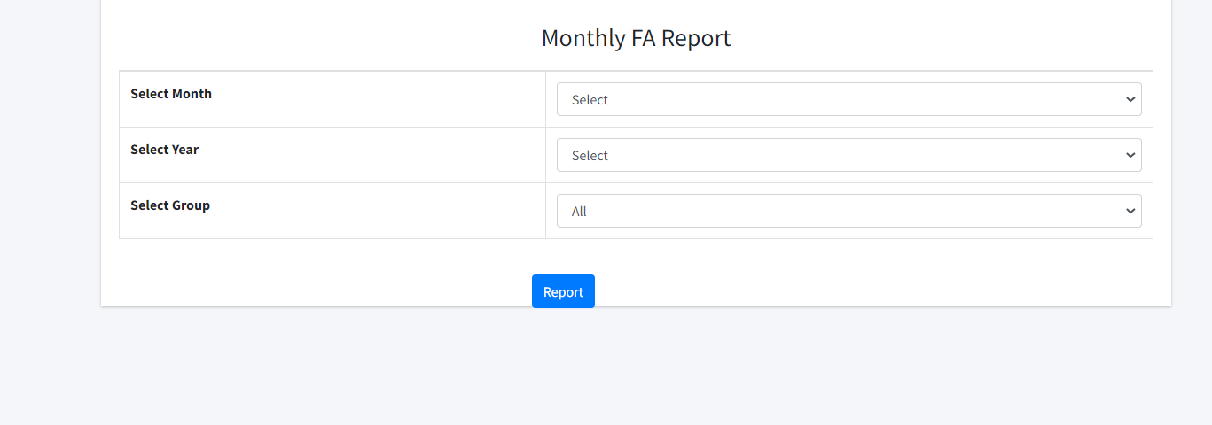
How Will get Financial year/Monthly Reports?
Click on the Financial year/Monthly Reports
Select Month
Select Year
Select Group
Click on report

Slide 63
How Will get Yearly FA/IT Reports?
Click on the yearly FA/IT Reports
Select Group
Select Financial Year
Click on Generate report

Slide 64
How Will get Procurement Type Reports?
Click on Procurement Type Reports
Select the Asset Group
Select the Type of Import
Select the Type Asset
Click on Report.

Slide 65
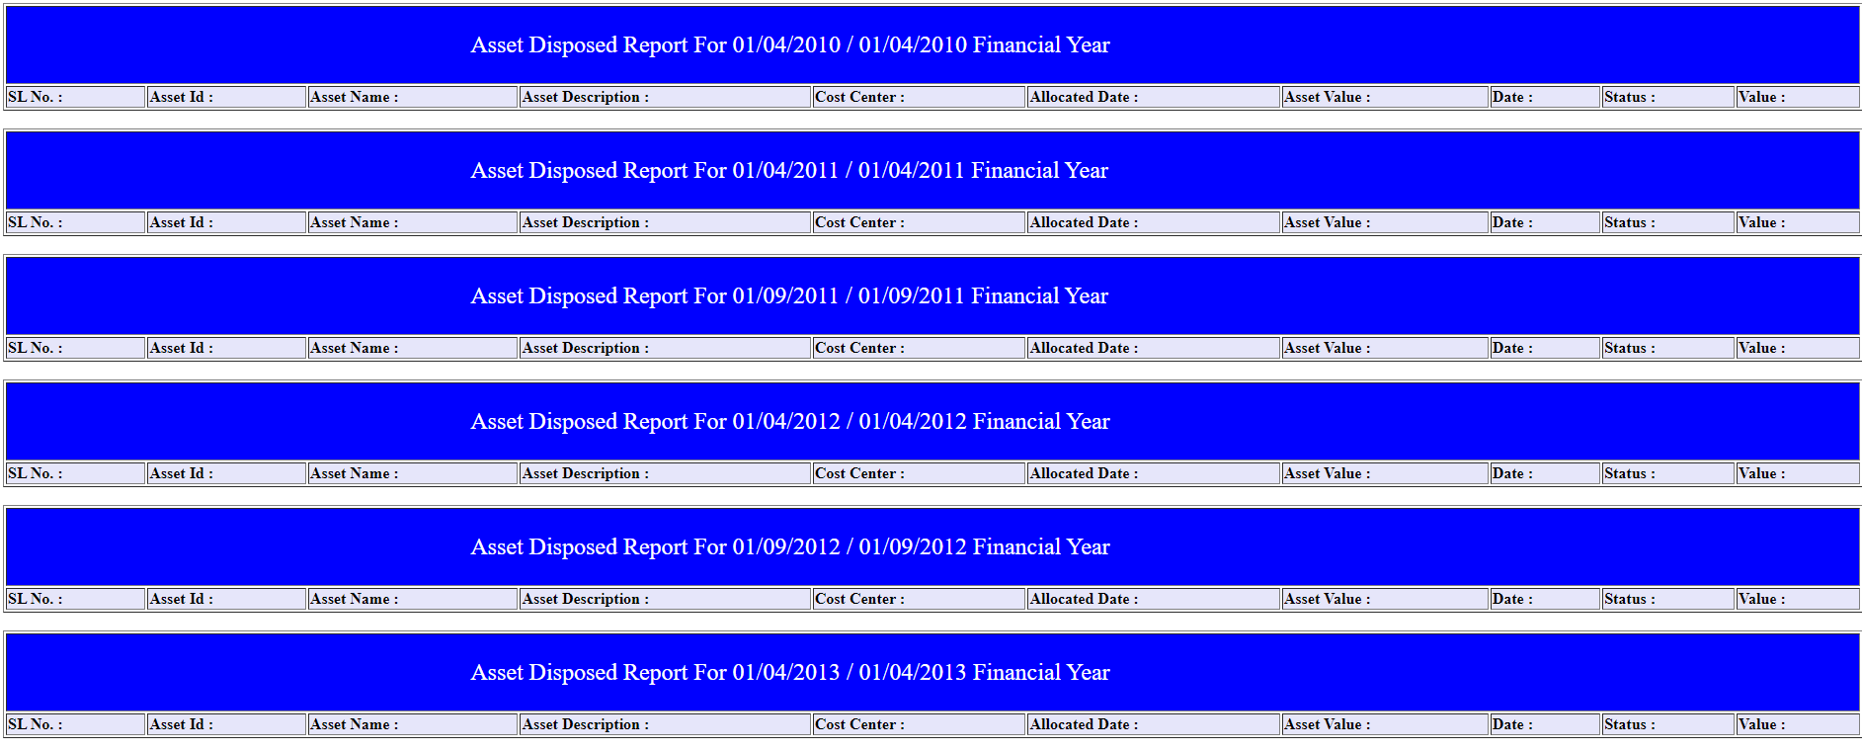
How Will get Assets Disposed Reports?
Click on the Asset Disposed Reports
Select the Dispose Type
Select the Asset Group
Select the Financial Year
Click on Generate Report we will get excel sheet.

Slide 66
How Will get Consolidated (CA) Reports?
Click on the Consolidated (CA) Reports
Select the Financial Year
Click on Generate Report we will get excel sheet.

Slide 67
How Will get Consolidated (IT) Reports?
Click on the Consolidated (IT) Reports
Select the Financial Year
Click on Generate Report we will get excel sheet.

Slide 68
How Will get AMC/Warranty Reports?
Click on the AMC/Warranty Report
Select the AMC/Warranty
Drop down on the Start Date
Drop down on the End Date
Click on report.

Slide 69
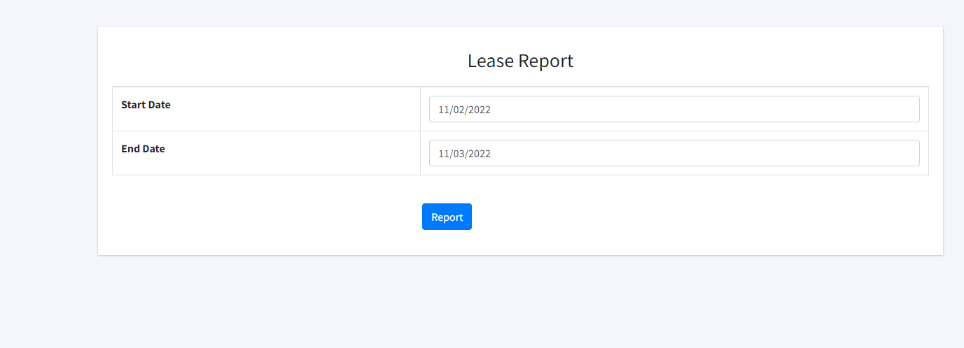
How Will get Lease Reports?
Click on the Lease Report
Drop down on the Start Date
Drop down on the End Date
Click on report.

Slide 70
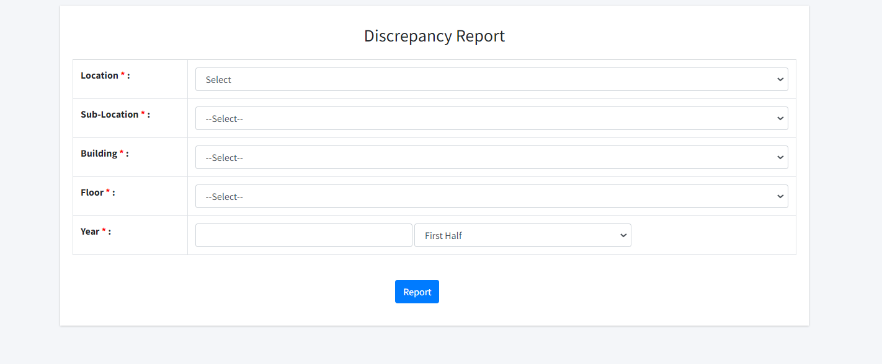
How Will get Discrepancy Reports?
Click on the Discrepancy report
Drop down Location
Drop down Sub Location
Drop down Building and Floor, Year.
Click on report.

Slide 71
How to Create Depreciation/Depreciation Master?
Click on the Depreciation Master
Put Income Tax Act(WDV)
Put Company Act(SLM)
Click on Save.

Slide 72
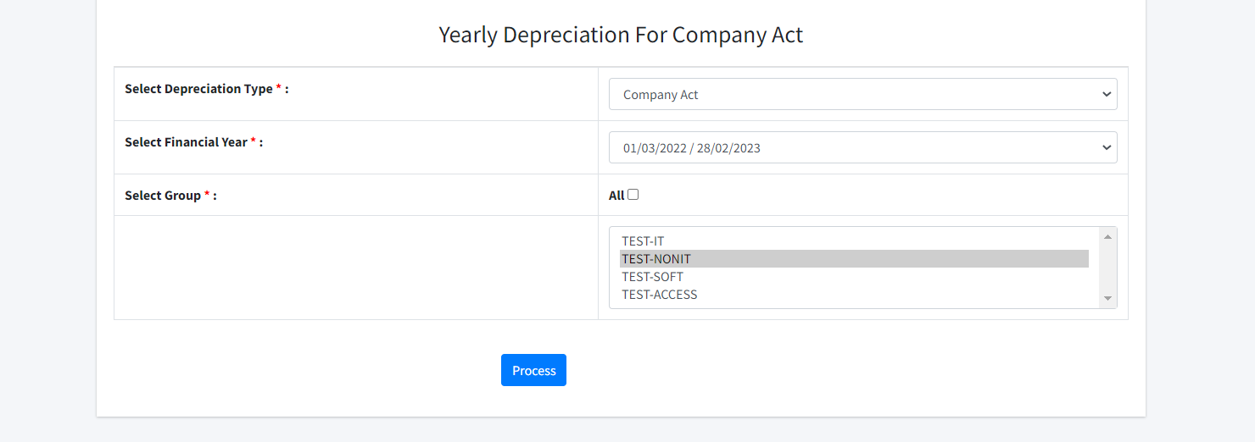
How to Create Yearly Depreciation?
Click on the Yearly Depreciation
Select the Depreciation Type
Select the financial Year
Select the Group
Click on Process

Slide 73
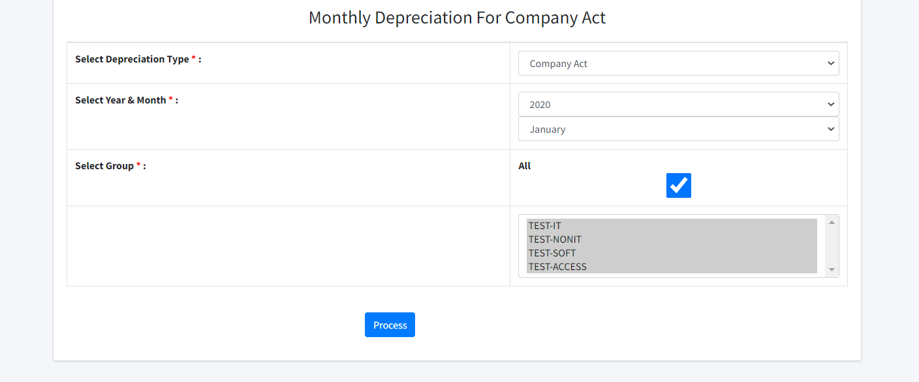
How to Create Monthly Depreciation?
Click on the Monthly Depreciation
Select the Depreciation Type
Select the Year and Month
Select the Group
Click on Process

Slide 74
How to Create Depreciation config(CA Yearly) ?
Click on Depreciation Config(CA Yearly)
Click on start Date of Depreciation the date to be considered as the start date of Depreciation.
Write Off Value
Drop down No of days to be considered
Click on Save

Slide 75
How to Create Depreciation config(IT Act) ?
Click on Depreciation Config(IT Act)
Click on start Date of Depreciation the date to be considered as the start date of Depreciation.
Write Off Value
Drop down No of days to be considered
Click on Save

Slide 76
How to Create Addition and Deletion ?
Click on the Addition and Deletion
Drop down Financial year
Drop down Asset group
Drop down Asset sub group
Click on Next
Drop down Asset ID and Click on Next.

Slide 77
How to Create Addition and Deletion ?
You get Register of Fixed assets it will be already Fully Fill
Drop down Addition /Deletion
You can Recovery Date
You can Recovery Amount
Click on Remarks
Click on Save

Slide 78
How to Create Transfer(Intra Transfer And Transfer Request)?
Click on Transfer/Intra Transfer
Click on Transfer Request
Drop down the Location
Drop down the Sub location
Drop down the Building
Click on Next and Send Request

Slide 79
How to Create Transfer(Intra Transfer In Transfer Approval)?
Click on Transfer/Intra Transfer
Click on Transfer Approval
Click on Preview

Slide 80
How to Create Transfer(Intra Transfer In Transfer )?
Click on Transfer Date
Put the Date
Click on Transfer or Cancel

Slide 81
How to Create Transfer(Intra Transfer In Transfer Request)?
Click on Transfer/Intra Transfer
Click on Transfer Request
Drop down the Location
Drop down the Sub location
Drop down the Building and floor
Click on Next and Send Request.

Slide 82
How to Create Transfer(Intra Transfer In Apptoval)?
Click on Transfer/Intra Transfer
Click on Transfer Approval

Slide 83
How to Create Transfer(Intra Transfer In Transfer )?
Click on Transfer Date
Put the Date
Click on Transfer or Cancel

Slide 84
How to Create Transfer(Intra Transfer/Print gate pass)?
Click on Preview
Get the NON Returnable Gate Pass

Slide 85
How to Create Transfer(Intra Transfer/Receive Asset)?
Click on Preview
Get the Returnable Gate Pass

Slide 86
How to Create New Ticket?
Request Details
Ticket Number
Select the Requested Date
Put your Phone Number
Put your short Description
Put your Work Notes
Click on Submit.

Slide 87
How to Create Help/Assigned?
In Helpdesk assigned ticket , The ticket will be assigned to the concerning Department.
Select Department
Select Group
Assign to the Concerning team member from dropdown.

Slide 88
How to Create Help/In Progress Ticket?
Once, ticket is allocated to the Concerning team member, he / she will put the Status to In-Progress.
And Intimate the raised issue.

Slide 89
How to Create Help/Closed?
Once the Issue is get Resolved by the Technical Team
Ticket status will change to Closed.

Slide 90
How to Create Help/All Ticket?
This the Dashboard of Ticket
Here, All Ticket Dashboard will reflect.
Likewise, New Ticket , Closed , In-progress etc.

Slide 91
Thank You
Created by
N:Ramprasad Kulkarni
E: ramprasad@hcstechno.com

